Slide 1

Capital Market Overview
The capital market is a marketplace where buyers and sellers can trade financial instruments like stocks, bonds, and other securities. It plays a crucial role in allocating capital, providing liquidity, and driving economic growth.
AM
by Anoop Mohanty

Slide 2

Private Placement - Definition and Examples
A private placement is a method of raising capital by selling securities directly to a small group of investors, rather than through a public offering. This is often used by companies that need funding but don't want to go through the rigorous process of a public offering. Examples include venture capital, angel investors, and institutional investors.
Venture Capital
Angel Investors
Venture capital firms invest in high-growth companies with the potential for substantial returns. They often take an active role in the company's management.
Angel investors are wealthy individuals who invest in early-stage companies, often in exchange for equity.
Institutional Investors
Institutional investors are large organizations, such as pension funds, insurance companies, and mutual funds, that invest in securities.

Slide 3
Offer for Sale - Definition and Example
An offer for sale is a method of raising capital by selling existing shares of a company to the public. This is done through an underwriter, who purchases the shares from the company and then sells them to investors. This is a way for a company to raise capital without issuing new shares. An example would be a company that wants to raise money to expand its operations.
Company
Underwriter
Investors
The company that is issuing the shares for sale. This could be a publicly traded company or a private company looking to go public.
A financial institution that purchases the shares from the company and then sells them to investors. They act as an intermediary between the company and the public.
Individuals or institutions that purchase the shares from the underwriter. They are looking to invest in the company and receive returns on their investment.

Slide 4

SURCON - Meaning and Importance
SURCON stands for "Surrender of Convertibles". It refers to the process where holders of convertible securities choose to surrender their securities for the underlying shares of the company. This can be a positive signal for the company, as it indicates investor confidence in the company's future prospects.
1
Increased Equity
2
Reduced Debt
The company gains more equity capital by issuing shares to the convertible security holders.
The company's debt burden decreases as the convertible securities are converted to equity.
3
Improved Financial Position
The company's overall financial position improves, leading to greater stability and potential for growth.

Slide 5
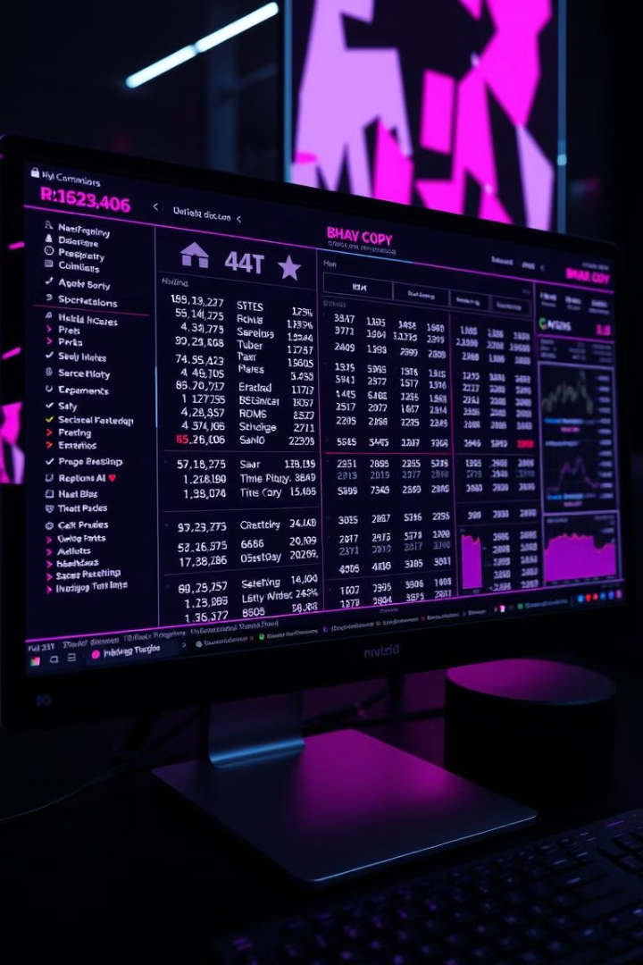
Bhav Copy - Specimen and Interpretation
The Bhav copy is a daily report that provides information on the closing prices of all securities traded on a stock exchange. It is a crucial document for market participants and analysts, as it provides an overview of market performance and helps in understanding price trends.
Security Code
Security Name
Closing Price
Change from Previous Day
123456
ABC Limited
100
+5
789012
XYZ Company
50
-2

Slide 6




ISIN - Meaning and Significance for Securities
ISIN stands for "International Securities Identification Number". It is a unique 12-character alphanumeric code that identifies a specific security, regardless of where it is traded. It helps to streamline trading and reduces the risk of errors, making it easier to track and manage securities across different markets.
Identification
Each security has a unique ISIN, making it easy to identify and distinguish from other securities.
Global Standardization
The ISIN is used worldwide, providing a consistent method for identifying securities across different countries.
Streamlined Trading
The ISIN simplifies trading by providing a clear and concise way to identify securities for both buyers and sellers.

Slide 7
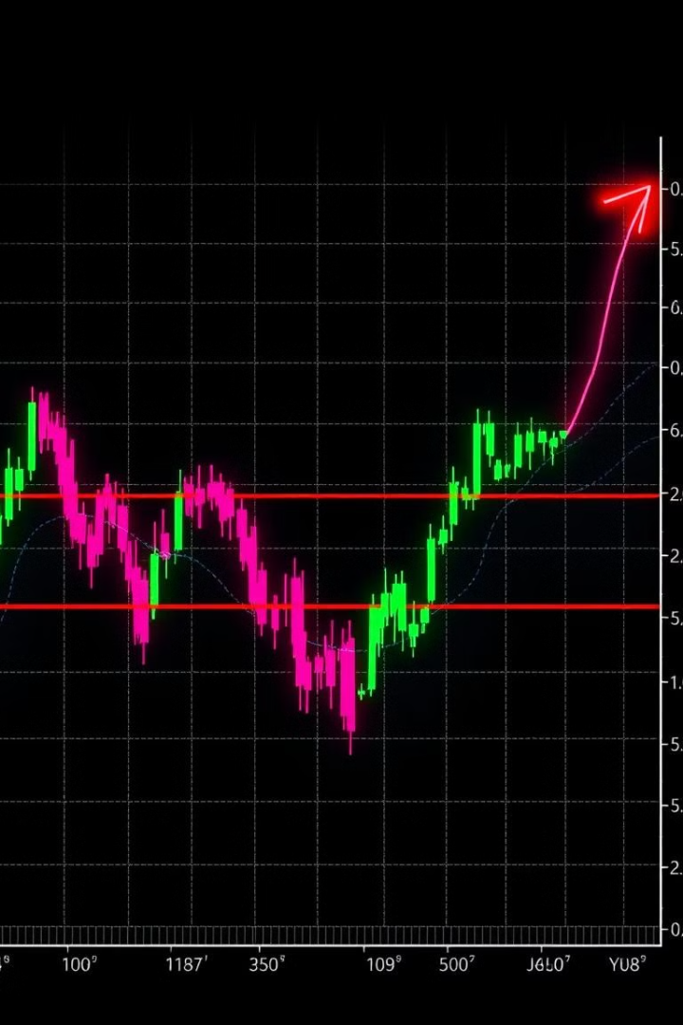



Circuit Filter - Upper and Lower Circuit Examples
A circuit filter is a mechanism used by stock exchanges to prevent excessive price fluctuations in a single trading day. It sets upper and lower limits on the price movement of a security. If a stock hits the upper circuit, it cannot rise further for the day, and if it hits the lower circuit, it cannot fall further.
Upper Circuit
A stock price reaches the upper limit and cannot rise further for the day.
Trading Halt
Trading in the security is halted temporarily to prevent further price fluctuations.
Lower Circuit
A stock price reaches the lower limit and cannot fall further for the day.

Slide 8
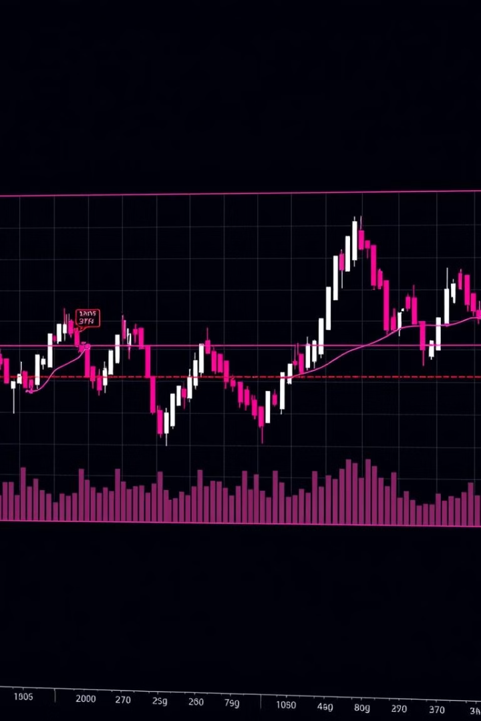
Trading Bands - Concept and Significance
Trading bands are defined price ranges within which a security is allowed to trade. They are set by market makers or exchanges to provide stability and prevent extreme price movements. They can be based on historical price data, volatility, or other factors.
1
Price Stability
2
Risk Management
Trading bands help to prevent extreme price fluctuations, creating a more stable and predictable market.
They provide a framework for risk management, as investors know the limits within which a security can trade.
3
Market Efficiency
Trading bands can promote market efficiency by preventing wild swings in prices, allowing for more informed trading decisions.

Slide 9

Margin Trading - Explanation and Importance
Margin trading is a method of trading securities using borrowed money. It allows investors to leverage their capital, increasing potential profits but also amplifying losses. The investor needs to provide a margin deposit, which is a portion of the total value of the investment. Margin trading requires careful consideration of the risks involved and should be undertaken only by experienced investors.
1
Investor Deposits Margin
The investor provides a deposit as a percentage of the total value of the investment.
2
Broker Loans Additional Funds
The broker lends the remaining funds needed to purchase the securities.
3
Investor Trades Securities
The investor trades the securities using the borrowed funds and their own deposit.
4
Profits and Losses Magnified
Both profits and losses are amplified due to the leverage used in margin trading.

Slide 10
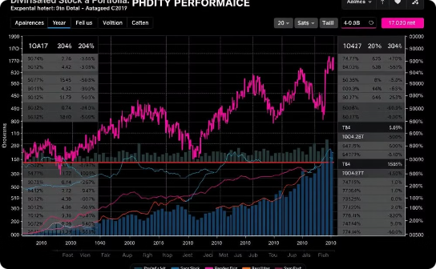


Basket Trading - Concept and Benefits
Basket trading involves buying or selling a group of securities as a single unit, rather than trading each security individually. This is often used by investors who want to diversify their portfolios or gain exposure to a specific sector or market. The securities in a basket are typically selected based on certain criteria, such as industry, market capitalization, or investment strategy.
Diversification
Convenience
Strategic Allocation
Investors can diversify their portfolios by investing in a basket of securities, reducing risk.
It allows investors to trade a group of securities with a single order, simplifying the trading process.
It allows investors to strategically allocate their capital across a group of securities, aligning with their investment goals.

